Slide 1
TreeLOG
PUMA Team
CSIT 551
Montclair State University

Slide 2
Team Puma
Moaath Alrajab | Instructor
Members of the PUMA team
Eliezer Epstein | Classes and methods to work with Google Map and coordinates, related UI
Elion Limanaj | DB DAO's, user Auth, Auth related UI, location detection
Inga Gaidukova | UI, classes and methods for UI to DB integration
Supriya Karambe | Classes and methods to work with Photos, related UI
Zahid Aziz | DB DAO's, user Auth, Auth related UI

Slide 3
Contents
Introduction
Competitive Solutions
Approach to new Solution
Application –Workflow
Application – Activities in details
Improvement in Application
Limitations of Application
Future Work

Slide 4
Municipal need
Submitter: Camden
In order to improve the quality of the City's street tree inventory, a more efficient way to survey and get baseline data on street trees would better manage risk, the health and growth of its canopy. Crowd sourcing capabilities are also needed. Currently, volunteers carry physical spreadsheets to catalogue a street tree location, health, general size, type, potential hazards. Some of that info is then uploaded to a Google Map.

Slide 5
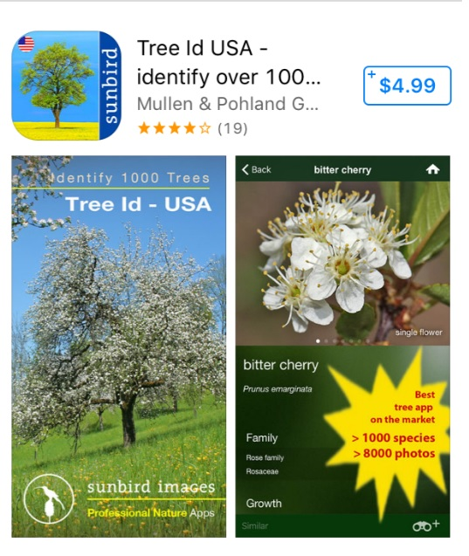
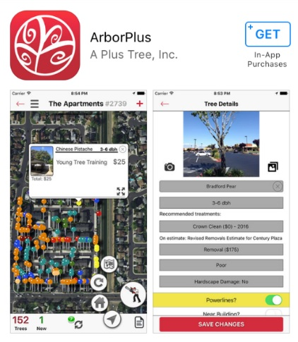
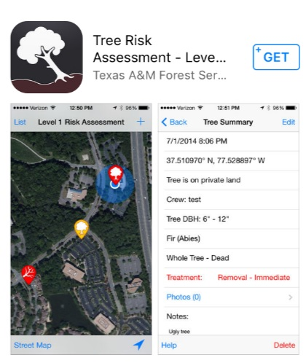
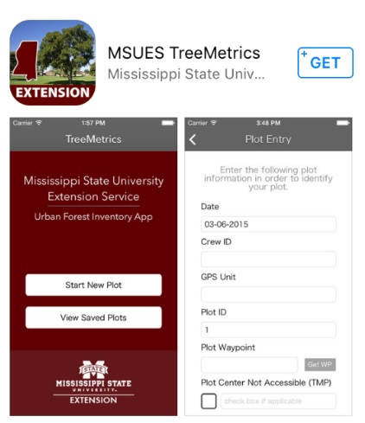
Competitive Solution

Slide 6
New Approach to Solution
Multi user Mobile application which locates GPS coordinates on the field, allows to save description of the tree in the database with photo making and leaves recognition capabilities for Android platform devices.

Slide 7
Target users and devices
Volunteers from Sustainable Camden County Municipality, who are mapping trees, are the future users of the application. The Application will be created for the devices with Android platform.

Slide 8
Social Impact
Short term impact
Conduct an inventory of all trees in the city in order to identify their health, remove diseased trees, potential danger to people.
Long term impact
The main purpose to have the inventory of the trees is for getting grants that the city can use to replant certain areas and neighborhoods. The city should have a coverage of 20% with trees, but currently only have 8-9% coverage.

Slide 9
Objectives
Function | Action
Track GPS location of the tree | Will mark the coordinates of the tree and save to the database
Photo uploading capabilities | Will use phone's camera to make picture in the application interface with option to save in the database
Identify hazards | Will use preset data for usability and identifying a level of the hazard for future actions.
Storing all tree related data in database | All data will be saved in a database
Login options (regular, google+) | Will allow to use the application

Slide 10
Technologies Used
Android Studio
Firebase Database
Google Play Services

Slide 11
Application Workflow
New Tree
Tree List in Area
Make photo
Map
Log Out
Exit
Login
Welcome Page

Slide 12
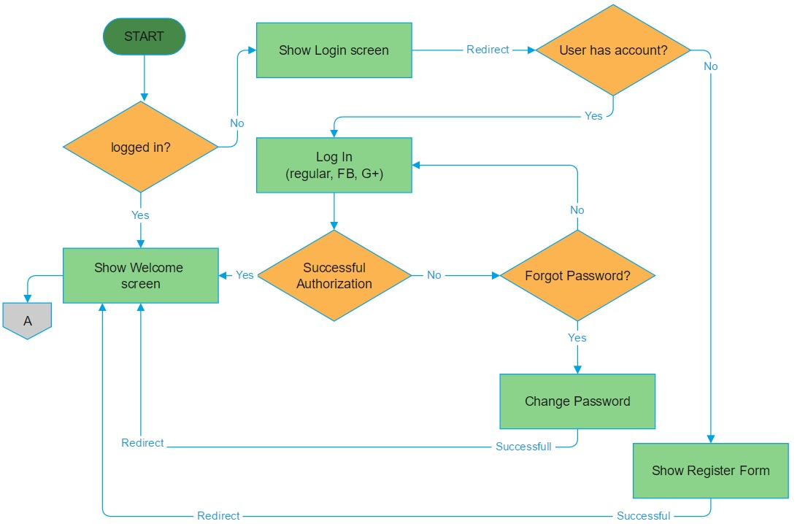
Login Workflow

Slide 13
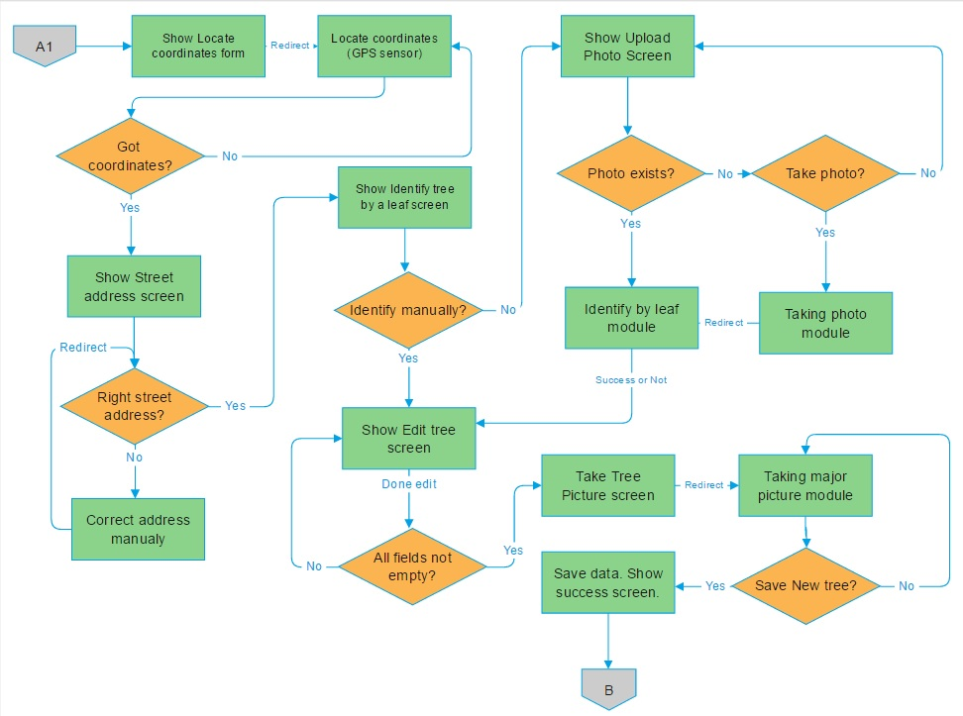
Create New Tree

Slide 14
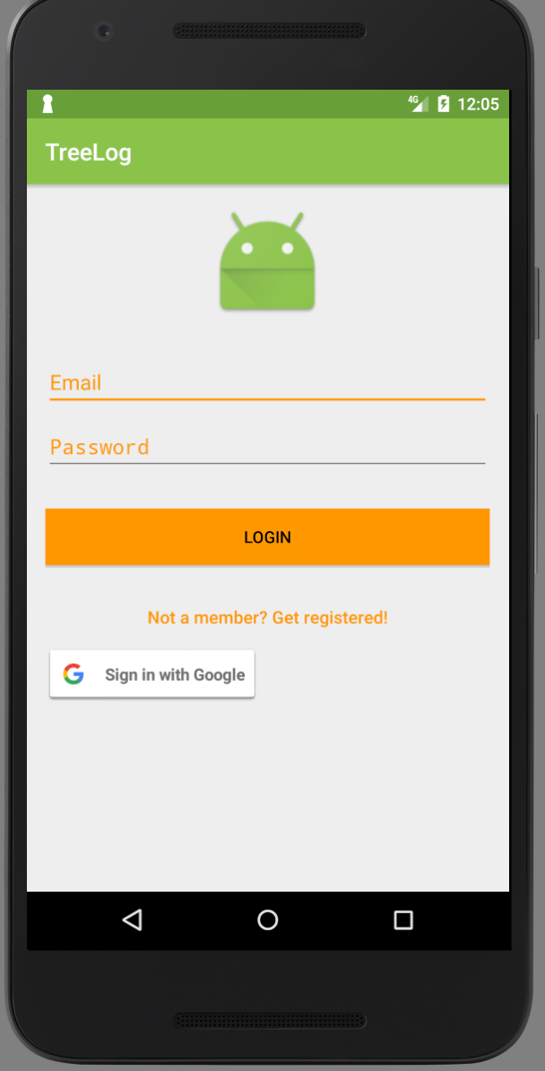
Login Activity
User Can Login Using 2ways 1. Regular Email id and Password. 2. User can use his /her existing google id and password If user is not registered , he will go to Registration Activity

Slide 15
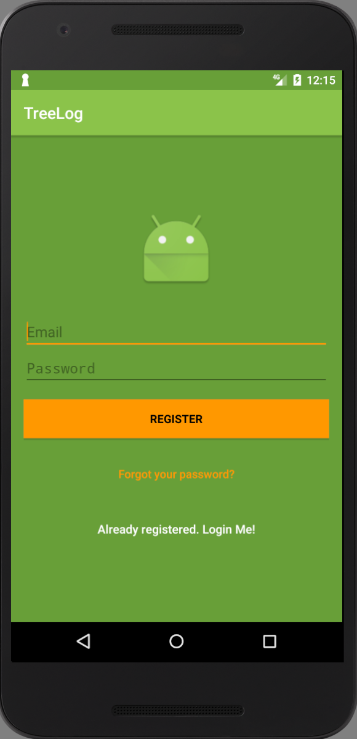
Registration Activity
 | User can register, using email id and password . Once he entered email and password, he will able to login TreeLog app, using regular login email id.

Slide 16
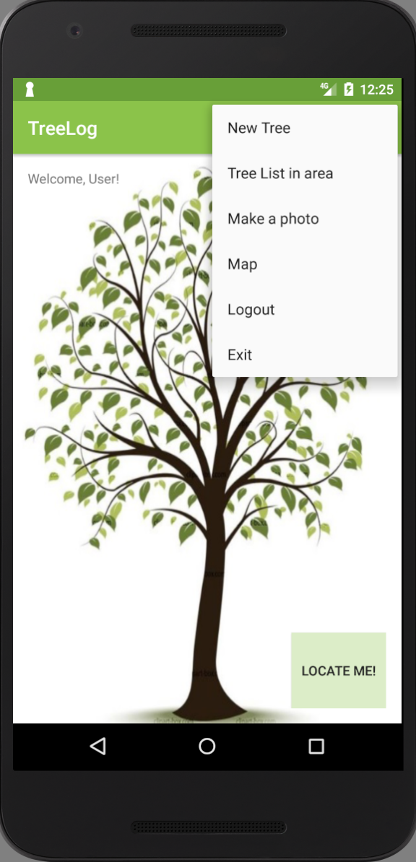
Welcome Activity
Once User logged in he can see Welcome Screen There are menu available to do different activity related to Tree. 1.New Tree 2.Tree List in Area 3.Make a photo 4.Map 5.Logout 6. Exit

Slide 17
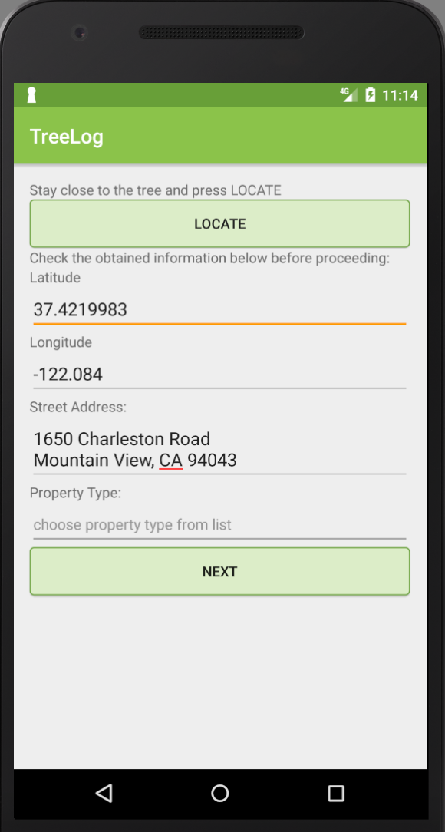
New Tree
 | User can create new tree in database using this New Tree. Locate button- Shows the geo coordination of tree which is nearby. Or user can add manually Latitude, longitude, Street of that tree. Property field - private or public property. Continue…

Slide 18
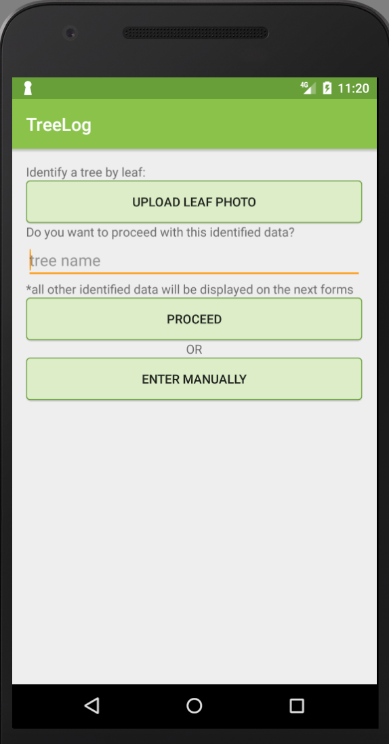
User can add Tree name. There are two option- 1. User can proceed with information fetched form database. 2.He can add add manually information of tree.

Slide 19
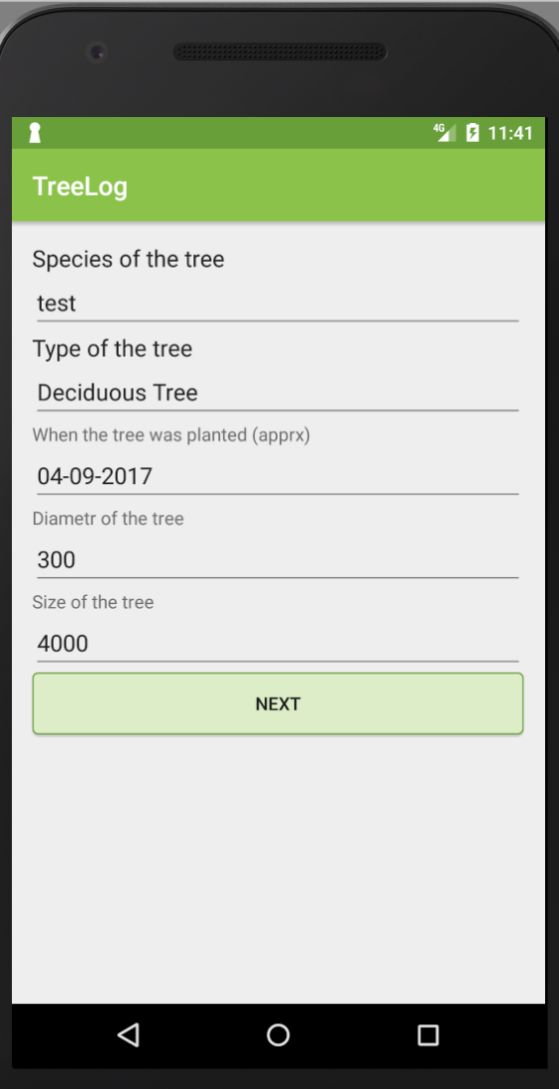
TreeData(Draft)
 | Here we will add video --- As To save Tree data we are having 4-5 slides..

Slide 20
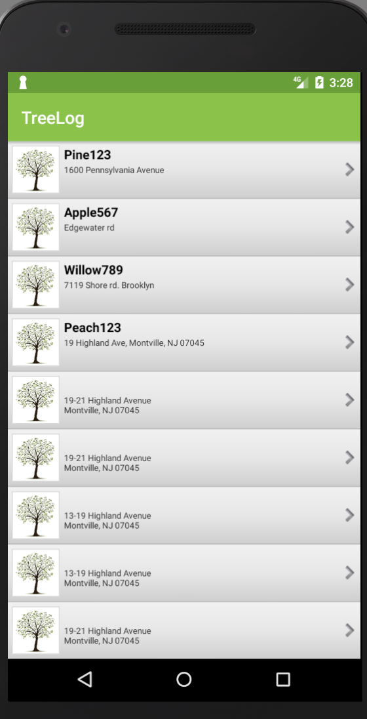
Tree List in Area
Tree List in Area Menu displays all available trees in that particular area. User can click on any tree from list to get details of that tree.

Slide 21
Scalability
The TreeLOG application can be used not only in Camden but also in other municipalities and areas for the inventory of trees in parks and on the streets, because it is based on the fixation of coordinates.

Slide 22
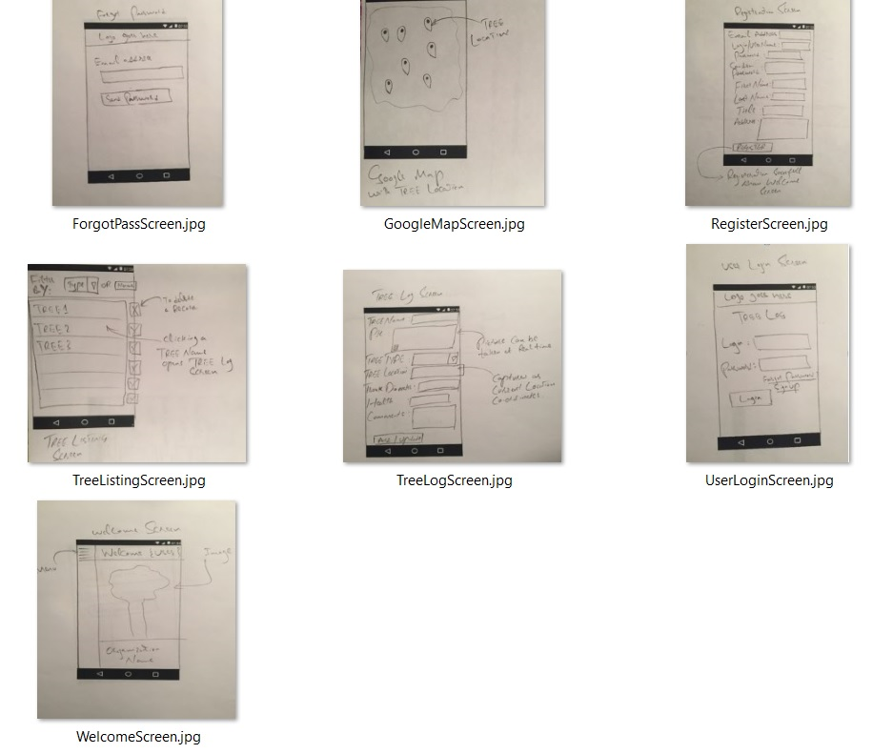
Preliminary Sketches

Slide 23
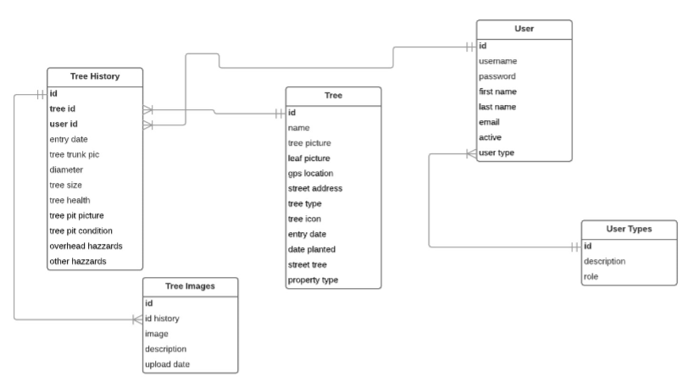
Tree Log Data Model

Slide 24
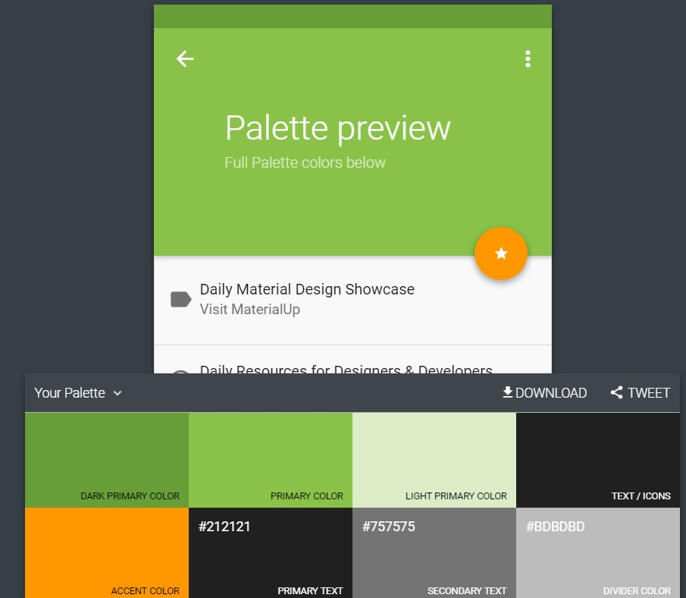
Palette

Slide 25
PUMA Team
Members of the PUMA team
Inga Gaidukova | Project Manager
Jose Orozco | Documentation Leader
Zahid Aziz | Design Leader
Elion Limanaj | Coding Leader

